Slide 1
Chap 5
The Evolution Trees

Slide 2
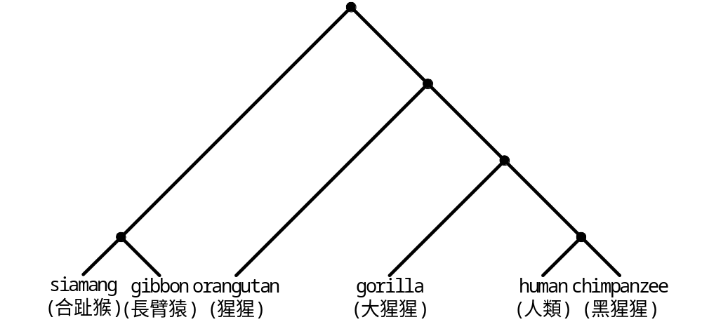
Evolutionary Tree

Slide 3
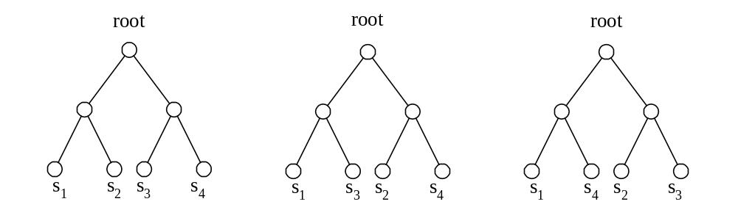
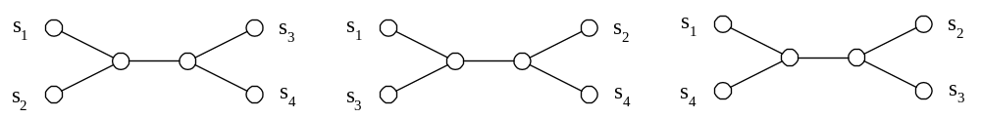
Tree Topology
Rooted tree
Unrooted tree

Slide 4
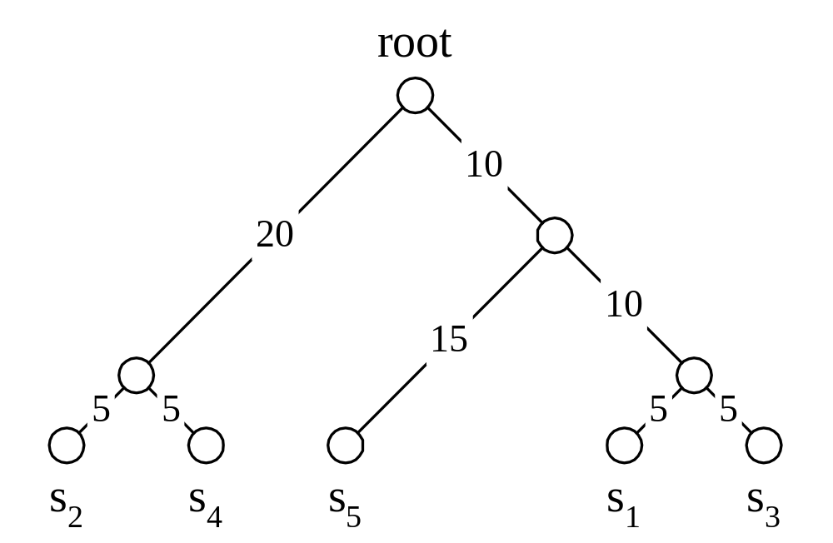
Distance Matrix and Rooted Tree
 | s₁ | s₂ | s₃ | s₄ | s₅
s₁ | 0 | 50 | 10 | 50 | 30
s₂ | 50 | 0 | 50 | 10 | 50
s₃ | 10 | 50 | 0 | 50 | 30
s₄ | 50 | 10 | 50 | 0 | 50
s₅ | 30 | 50 | 30 | 50 | 0

Slide 5
Distances Relation
dt(s_{i}, s_{j}): the distance between species s_{i} and s_{j} in an evolution tree
d(s_{i}, s_{j}): the distance between species s_{i} and s_{j} in the distance matrix
dt(s_{i}, s_{j}) ≥ d(s_{i}, s_{j})
s₁ = agctccca s₁ = agctccca
s₂ = agccccca s'₁ = agcaccca
d(s₁, s₂) = 1 s₂ = agccccca
dt(s₁, s₂) = 2

Slide 6
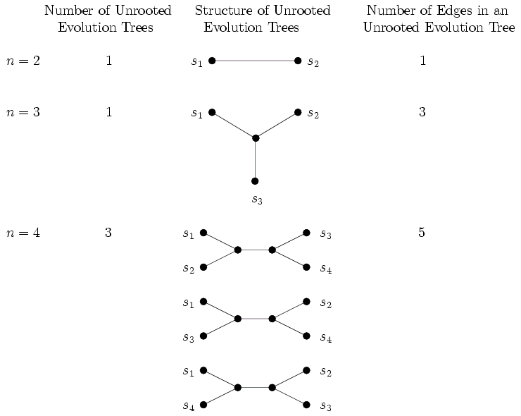

Slide 7
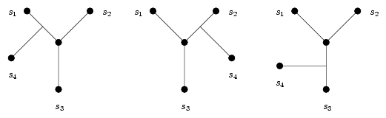
Numbers about Unrooted Tree
Number of edges of an unrooted evolurion tree
NE(n) = 2n − 3
Number of unrooted evolution trees for n species
TU(n + 1) = (2n − 3) × TU(n)
TU(n) = (2n − 5) × (2n −7) × ⋅⋅⋅ × 1

Slide 8
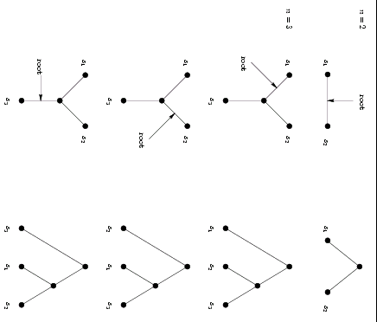

Slide 9
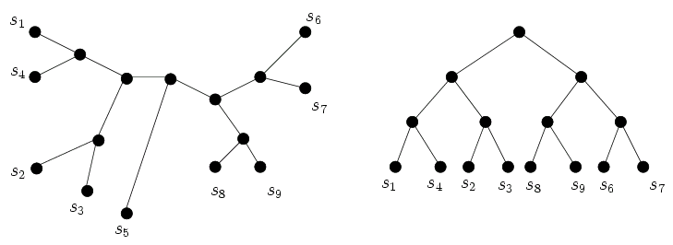
An Unrooted Evolution Tree with an Outlier Species

Slide 10
Different Tree Specifications
Minimax evolution trees
  The maximum of (dt(s_{i}, s_{j}) − d(s_{i}, s_{j})) is minimized.
Minisum evolution trees
  The total sum of all pairs of distances among leaf nodes is minimized.
Minisize evolution trees
  The total length of the tree is minimized.

Slide 11
Complexities of Evolution Tree Problems
 | Minimax | Minisum | Minisize
Unrooted | NP-complete | NP-complete | Unknown
Rooted | O(n²) | NP-complete | NP-complete

Slide 12
The Rooted Minimax Evolution Tree Algorithm (1)
Find the longest distance in the distance matrix
 | s₁ | s₂ | s₃ | s₄
s₁ | 0 | 2 | 3 | 3.1
s₂ |  | 0 | 3.6 | 5
s₃ |  |  | 0 | 1
s₄ |  |  |  | 0

Slide 13
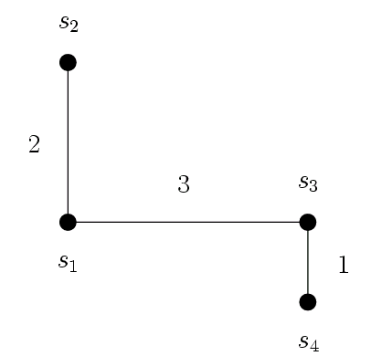
Example of the Rooted Minimax Evolution Tree Algorithm (2)
Construct a minimal spanning tree

Slide 14
Example of the Rooted Minimax Evolution Tree Algorithm (3)
Break the longest edge in path from s₂ to s₄

Slide 15
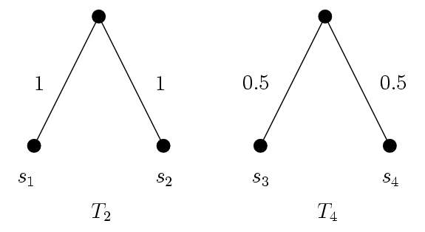
Example of the Rooted Minimax Evolution Tree Algorithm (4)
Construct rooted subtrees

Slide 16
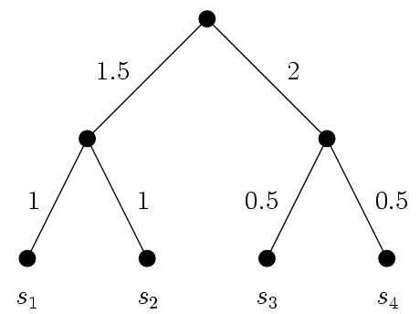
Example of the Rooted Minimax Evolution Tree Algorithm (5)
Combine subtrees by making sure that
dt(s₂, s₄) = d(s₂, s₄)

Slide 17
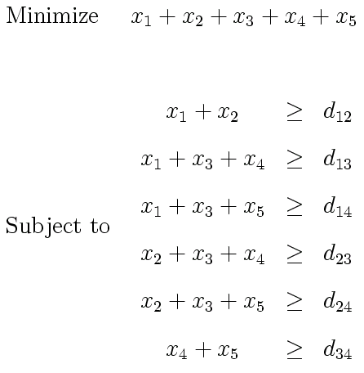
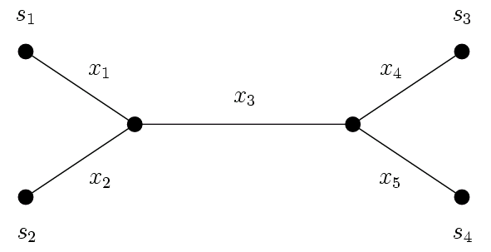
Weights Determination for a Tree with a Given Topology
Unrooted evolution tree

Slide 18
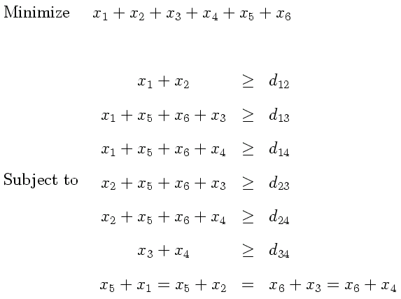
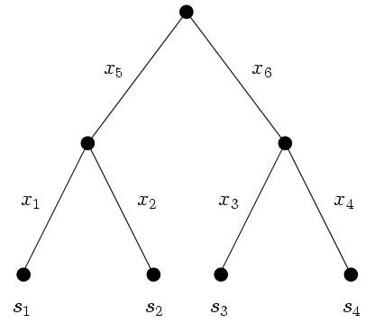
Weights Determination for a Tree with a Given Topology
Rooted evolution tree

Slide 19
UPGMA for Rooted Evolution Trees
Unweighted pair group method with arithmetic mean
Finding a rooted evolution tree with a given distance matrix
Greedy method
Heuristic solution

Slide 20
UPGMA (1)
Select the pair of species with the smallest distance
 | s₁ | s₂ | s₃ | s₄
s₁ | 0 | 4 | 4 | 3
s₂ |  | 0 | 6 | 5
s₃ |  |  | 0 | 2
s₄ |  |  |  | 0

Slide 21
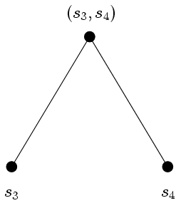
UPGMA (2)
Consider (s₃, s₄) as a new species.
d(s₁, (s₃, s₄)) = ½(d(s₁, s₃) + d(s₁, s₄)) = ½(4+3) = 3.5
d(s₂, (s₃, s₄)) = ½(d(s₂, s₃) + d(s₂, s₄)) = ½(6+5) = 5.5
d(s₁, s₂) = 4
 | s₁ | s₂ | (s_{3,} s₄)
s₁ | 0 | 4 | 3.5
s₂ |  | 0 | 5.5
(s₃, s₄) |  |  | 0

Slide 22
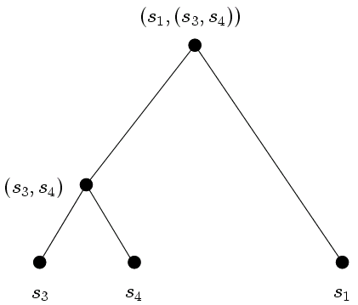
UPGMA (3)
Select the pair of species (s₁, (s₃, s₄)) with the smallest distance
 | s₁ | s₂ | (s_{3,} s₄)
s₁ | 0 | 4 | 3.5
s₂ |  | 0 | 5.5
(s₃, s₄) |  |  | 0

Slide 23
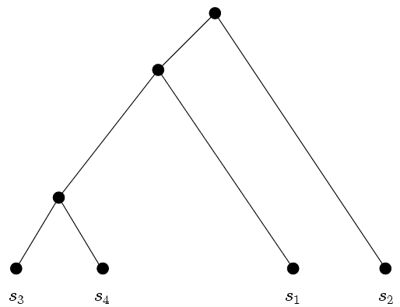
UPGMA (4)
Obtain the final evolution tree
Then use linear programming technique to produce an evolution tree for a given criteria

Slide 24
The Neighbor Joining Method for Unrooted Evolution Trees
Finding an unrooted evolution tree with a given distance matrix
Greedy method
Heuristic solution

Slide 25
Neighbor Joining Method (1)
Distance matrix
 | s₁ | s₂ | s₃ | s₄
s₁ | 0 | 4 | 4 | 3
s₂ | 4 | 0 | 6 | 5
s₃ | 4 | 6 | 0 | 2
s₄ | 3 | 5 | 2 | 0

Slide 26

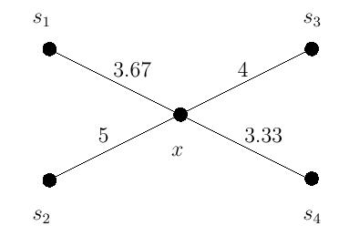

Neighbor Joining Method (2)
We first construct a 1-star

Slide 27
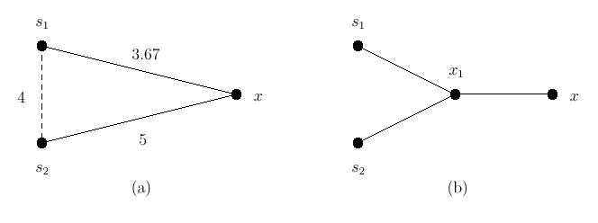
Neighbor Joining Method (3)
Select a pair of species, insert an internal node

Slide 28
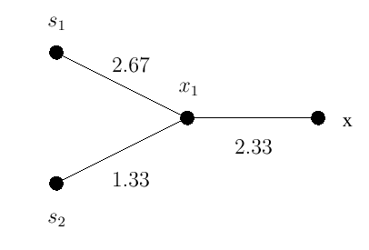



Neighbor Joining Method (4)
Calculate the new connection cost NC
Calculate the weights of edges

Slide 29
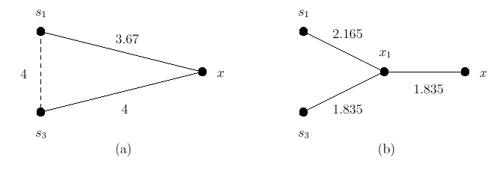
Neighbor Joining Method (5)
Select a pair of species, insert an internal node

Slide 30
Neighbor Joining Method (6)
Calculate the saved costs of all pairs
  The cost saved by pairing s₁ with s₄ is 2
  The cost saved by pairing s₁ with s₂ is 2.34
  The cost saved by pairing s₁ with s₃ is 1.835
  The cost saved by pairing s₂ with s₃ is 1.5
  The cost saved by pairing s₂ with s₄ is 1.67
  The cost saved by pairing s₃ with s₄ is 2.67

Slide 31
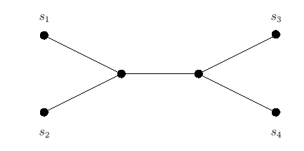
Neighbor Joining Method (7)
The final tree structure

Slide 32
An Approximation Algorithm for an Unrooted Minisize Evolution Tree
Finding an unrooted evolution tree with a given distance matrix
This algorithm is based upon minimal spanning tree
The approximate solution is never larger than twice of the size of an optimal solution

Slide 33
The Approximation Algorithm (1)
Distance matrix
 | s₁ | s₂ | s₃ | s₄
s₁ | 0 | 4 | 4 | 3
s₂ |  | 0 | 6 | 5
s₃ |  |  | 0 | 2
s₄ |  |  |  | 0

Slide 34
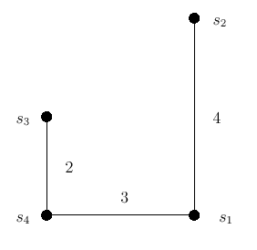
The Approximation Algorithm (2)
We first construct a minimal spanning tree out of distance matrix
  BFS order：s₄, s₃, s₁, s₂

Slide 35
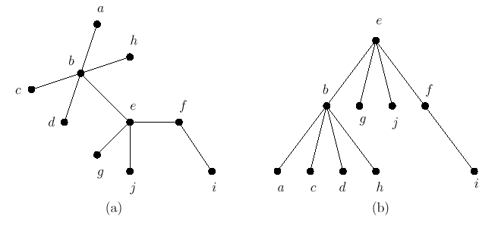
Example of this Approximation Algorithm (3)
Breadth first search
BFS order：e, b, g, j, f, a, c, d, h, i

Slide 36
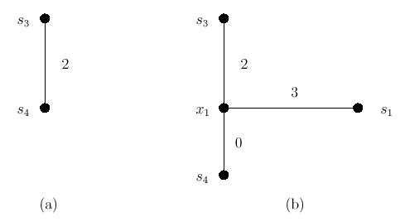
Example of this Approximation Algorithm (4)
Add nodes one by one
  s₄, s₃, s₁, s₂ s₄, s₃, s₁, s₂

Slide 37
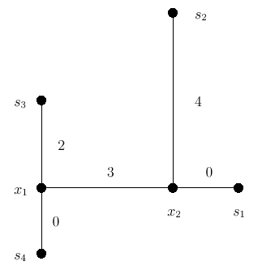
Example of this Approximation Algorithm (5)
An unrooted evolution tree transformed from the minimal spanning tree
  s₄, s₃, s₁, s₂

Slide 38
Proof(1)
We will prove that the total length of this unrooted evolution tree is less than or equal to twice of the length of an optimal unrooted minisize evolution tree.

Slide 39
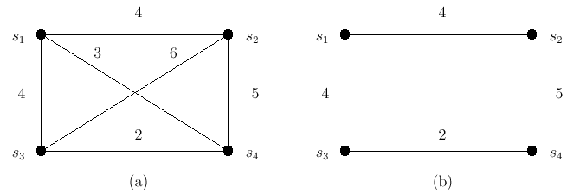
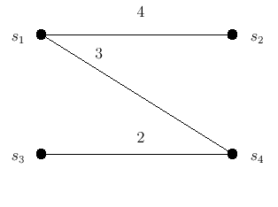
Proof(2)
|MST|<|TSP|
APP= |MST|<|TSP|
TSP is to find a Hamiltonian cycle with the smallest length.

Slide 40
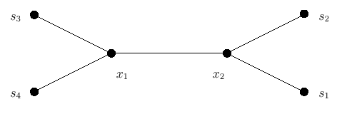
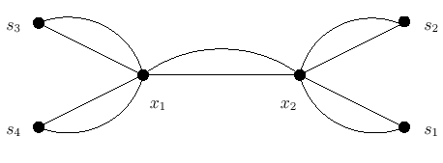
Proof(3)
Original evolution tree
The result of duplicating every edge in the tree

Slide 41

Proof(4)
|ET|=2|OPT|
|ET|=dt(s₁,s₂)+ dt(s₂,s₃)+...+ dt(s_{n-1},s_{n})+ dt(s_{n},s₁)
|CET|= d(s₁,s₂)+ d(s₂,s₃)+...+ d(s_{n-1},s_{n})+ d(s_{n},s₁)
|CET| |ET|
|TSP| |CET| |ET|=2|OPT|
APP= |MST|<|TSP|
APP<2|OPT|

Slide 42
The Minimal Spanning Tree Preservation Approach for Evolution Construction
Finding an unrooted evolution tree with a given distance matrix
The condition for our minimal spanning tree approach for the evolution tree construction problem is that MST(D) is an MST(D_{t})

Slide 43
Example (1)
A new distance matrix
 | 1 | 2 | 3 | 4 | 5 | 6
1 | 0 | 3 | 7 | 14 | 16 | 16.8
2 |  | 0 | 4 | 11 | 13 | 14
3 |  |  | 0 | 7 | 9 | 10.3
4 |  |  |  | 0 | 2 | 5.4
5 |  |  |  |  | 0 | 5
6 |  |  |  |  |  | 0

Slide 44
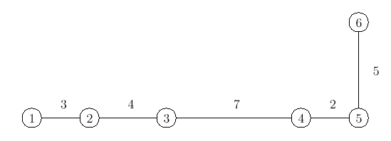
Example (2)
A minimal spanning tree constructed out of the new distance matrix
  e(4,5)=2, e(1,2)=3, e(2,3)=4, e(5,6)=5, e(3,4)=7

Slide 45
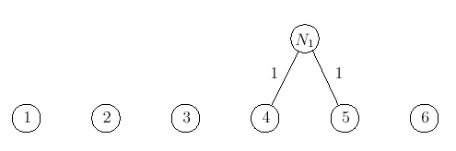
Example (3)
Construct the evolution tree
  e(4,5)=2, e(1,2)=3, e(2,3)=4, e(5,6)=5, e(3,4)=7

Slide 46
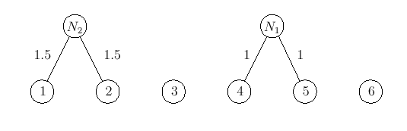
Example (4)
Construct the evolution tree
  e(4,5)=2, e(1,2)=3, e(2,3)=4, e(5,6)=5, e(3,4)=7

Slide 47
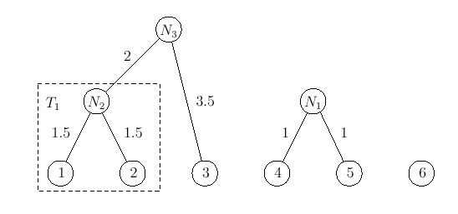
Example (5)
Construct the evolution tree
  e(4,5)=2, e(1,2)=3, e(2,3)=4, e(5,6)=5, e(3,4)=7

Slide 48
Example (6)
distance matrix
 | 1 | 2 | 3 | 4 | 5 | 6
1 | 0 | 3 | 7 | 14 | 16 | 16.8
2 |  | 0 | 4 | 11 | 13 | 14
3 |  |  | 0 | 7 | 9 | 10.3
4 |  |  |  | 0 | 2 | 5.4
5 |  |  |  |  | 0 | 5
6 |  |  |  |  |  | 0

Slide 49
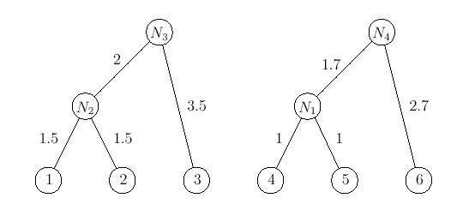
Example (7)
Construct the evolution tree
  e(4,5)=2, e(1,2)=3, e(2,3)=4, e(5,6)=5, e(3,4)=7

Slide 50
Example (8)
distance matrix
 | 1 | 2 | 3 | 4 | 5 | 6
1 | 0 | 3 | 7 | 14 | 16 | 16.8
2 |  | 0 | 4 | 11 | 13 | 14
3 |  |  | 0 | 7 | 9 | 10.3
4 |  |  |  | 0 | 2 | 5.4
5 |  |  |  |  | 0 | 5
6 |  |  |  |  |  | 0

Slide 51
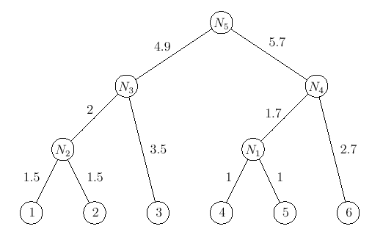
Example (9)
Construct the evolution tree
  e(4,5)=2, e(1,2)=3, e(2,3)=4, e(5,6)=5, e(3,4)=7

Slide 52
Example (10)
A new distance matrix
 | 1 | 2 | 3 | 4 | 5 | 6
1 | 0 | 3 | 7 | 14 | 16 | 16.8
2 |  | 0 | 4 | 11 | 13 | 14
3 |  |  | 0 | 7 | 9 | 10.3
4 |  |  |  | 0 | 2 | 5.4
5 |  |  |  |  | 0 | 5
6 |  |  |  |  |  | 0

Slide 53
Example (11)
The distance matrix Dt Based on the evolution tree
 | 1 | 2 | 3 | 4 | 5 | 6
1 | 0 | 3 | 7 | 16.8 | 16.8 | 16.8
2 |  | 0 | 7 | 16.8 | 16.8 | 16.8
3 |  |  | 0 | 16.8 | 16.8 | 16.8
4 |  |  |  | 0 | 2 | 5.4
5 |  |  |  |  | 0 | 5.4
6 |  |  |  |  |  | 0

Slide 54
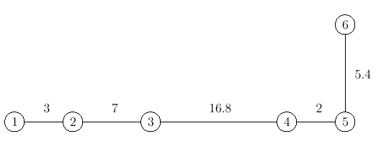
Example (12)
A minimal spanning tree based on Dt

